Slide 1
Delays
module example(input logic a, b, c,
output logic y);
logic ab, bb, cb, n1, n2, n3;
assign #1 {ab, bb, cb} = ~{a, b, c};
assign #2 n1 = ab & bb & cb;
assign #2 n2 = a & bb & cb;
assign #2 n3 = a & bb & c;
assign #4 y = n1 | n2 | n3;
endmodule
y = ~a & ~b & ~c | a & ~b & ~c | a & ~b & c;

Slide 2
Delays
module example(input logic a, b, c,
output logic y);
logic ab, bb, cb, n1, n2, n3;
assign #1 {ab, bb, cb} =
~{a, b, c};
assign #2 n1 = ab & bb & cb;
assign #2 n2 = a & bb & cb;
assign #2 n3 = a & bb & c;
assign #4 y = n1 | n2 | n3;
endmodule

Slide 3
Delays
1
module example(input logic a, b, c,
output logic y);
logic ab, bb, cb, n1, n2, n3;
assign #1 {ab, bb, cb} =
~{a, b, c};
assign #2 n1 = ab & bb & cb;
assign #2 n2 = a & bb & cb;
assign #2 n3 = a & bb & c;
assign #4 y = n1 | n2 | n3;
endmodule

Slide 4
Delays
2
module example(input logic a, b, c,
output logic y);
logic ab, bb, cb, n1, n2, n3;
assign #1 {ab, bb, cb} =
~{a, b, c};
assign #2 n1 = ab & bb & cb;
assign #2 n2 = a & bb & cb;
assign #2 n3 = a & bb & c;
assign #4 y = n1 | n2 | n3;
endmodule

Slide 5
Delays
module example(input logic a, b, c,
output logic y);
logic ab, bb, cb, n1, n2, n3;
assign #1 {ab, bb, cb} =
~{a, b, c};
assign #2 n1 = ab & bb & cb;
assign #2 n2 = a & bb & cb;
assign #2 n3 = a & bb & c;
assign #4 y = n1 | n2 | n3;
endmodule
2

Slide 6
Delays
module example(input logic a, b, c,
output logic y);
logic ab, bb, cb, n1, n2, n3;
assign #1 {ab, bb, cb} =
~{a, b, c};
assign #2 n1 = ab & bb & cb;
assign #2 n2 = a & bb & cb;
assign #2 n3 = a & bb & c;
assign #4 y = n1 | n2 | n3;
endmodule
4

Slide 7
Sequential Logic
SystemVerilog uses idioms to describe latches, flip-flops and FSMs
Other coding styles may simulate correctly but produce incorrect hardware

Slide 8
Always Statement
General Structure:
always @(sensitivity list)
statement;
Whenever the event in sensitivity list occurs, statement is executed

Slide 9
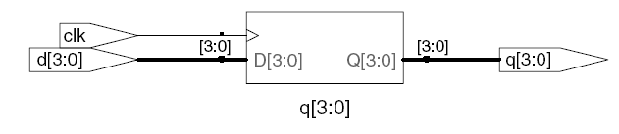
D Flip-Flop
module flop(input logic clk,
input logic [3:0] d,
output logic [3:0] q);
always_ff @(posedge clk)
q <= d; // pronounced “q gets d”
endmodule

Slide 10
Resettable D Flip-Flop
module flopr(input logic clk,
input logic reset,
input logic [3:0] d,
output logic [3:0] q);
// synchronous reset
always_ff @(posedge clk)
if (reset) q <= 4'b0;
else q <= d;
endmodule

Slide 11
Resettable D Flip-Flop
module flopr(input logic clk,
input logic reset,
input logic [3:0] d,
output logic [3:0] q);
// asynchronous reset
always_ff @(posedge clk, posedge reset)
if (reset) q <= 4'b0;
else q <= d;
endmodule

Slide 12
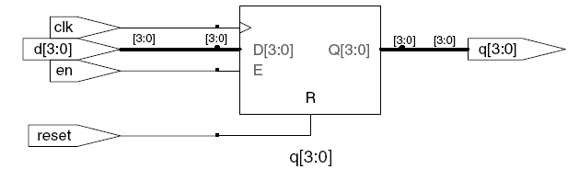
D Flip-Flop with Enable
module flopren(input logic clk,
input logic reset,
input logic en,
input logic [3:0] d,
output logic [3:0] q);
// enable and asynchronous reset
always_ff @(posedge clk, posedge reset)
if (reset) q <= 4'b0;
else if (en) q <= d;
endmodule

Slide 13
Latch
module latch(input logic clk,
input logic [3:0] d,
output logic [3:0] q);
always_latch
if (clk) q <= d;
endmodule
Warning: We don’t use latches in this text. But you might write code that inadvertently implies a latch. Check synthesized hardware – if it has latches
in it, there’s an error.

Slide 14
Other Behavioral Statements
Statements that must be inside always statements:
if / else
case, casez

Slide 15
Combinational Logic using always
// combinational logic using an always statement
module gates(input logic [3:0] a, b,
output logic [3:0] y1, y2, y3, y4, y5);
always_comb // need begin/end because there is
begin // more than one statement in always
y1 = a & b; // AND
y2 = a | b; // OR
y3 = a ^ b; // XOR
y4 = ~(a & b); // NAND
y5 = ~(a | b); // NOR
end
endmodule
This hardware could be described with assign statements using fewer lines of code, so it’s better to use assign statements in this case.

Slide 16
General Rules for Combinational Logic
If generic always is used, sensitivity list MUST include all signals used in the always.
all outputs should have default values or must be assigned for every input combination. If not, a latch will be generated to hold the current value.

Slide 17

Combinational Logic using case
module sevenseg(input logic [3:0] data,
output logic [6:0] segments);
always_comb
case (data)
// abc_defg
0: segments = 7'b111_1110;
1: segments = 7'b011_0000;
2: segments = 7'b110_1101;
3: segments = 7'b111_1001;
4: segments = 7'b011_0011;
5: segments = 7'b101_1011;
6: segments = 7'b101_1111;
7: segments = 7'b111_0000;
8: segments = 7'b111_1111;
9: segments = 7'b111_0011;
default: segments = 7'b000_0000; // required
endcase
endmodule

Slide 18
Combinational Logic using case
case statement implies combinational logic only if all possible input combinations described
Remember to use default statement

Slide 19
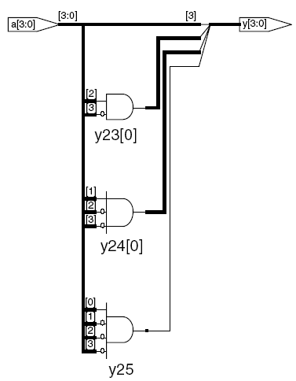
Combinational Logic using casez
module priority_casez(input logic [3:0] a,
output logic [3:0] y);
always_comb
casez(a)
4'b1???: y = 4'b1000; // ?=don’t care
4'b01??: y = 4'b0100;
4'b001?: y = 4'b0010;
4'b0001: y = 4'b0001;
default: y = 4'b0000;
endcase
endmodule

